Slide 1


PROJECT 4 Plots from Diamonds dataset
Presented by:
Nadim SAAD
Date: Monday Jan. 10th 2022

Slide 2
MATPLOTLIB CHARTS

Slide 3
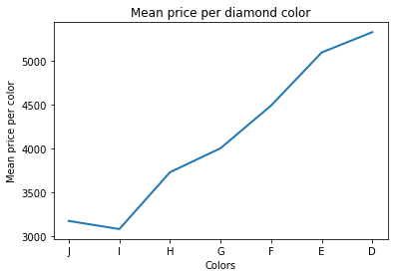
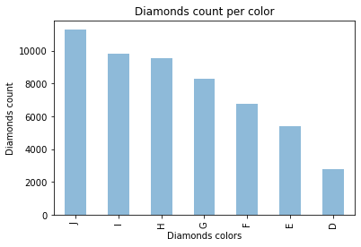
Line and Bar Charts

Slide 4
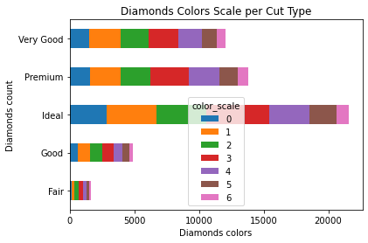
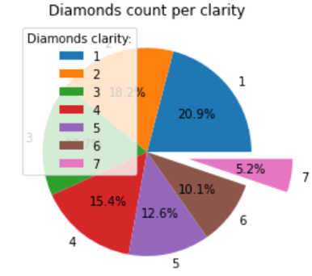
Colored Horizontal Bar & Pie Charts

Slide 5
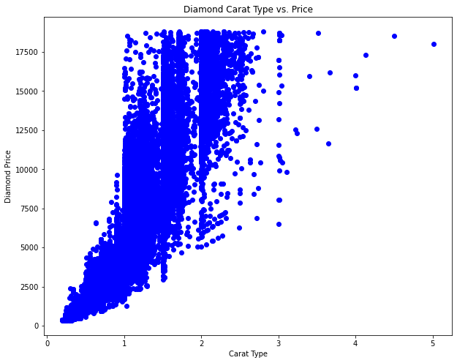
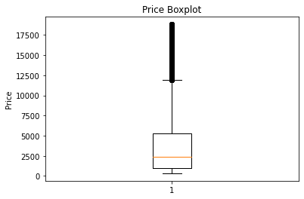
Boxplot & Scatter Charts

Slide 6
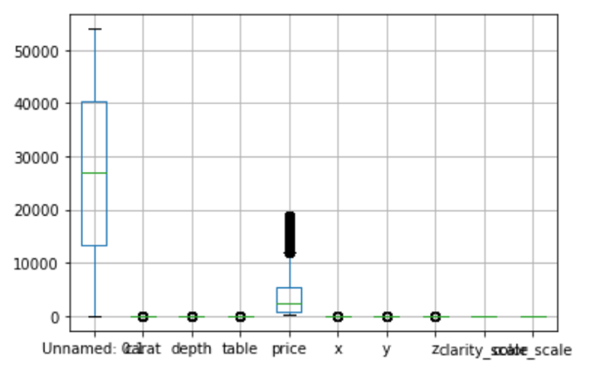
Boxplot

Slide 7
SEABORN CHARTS

Slide 8
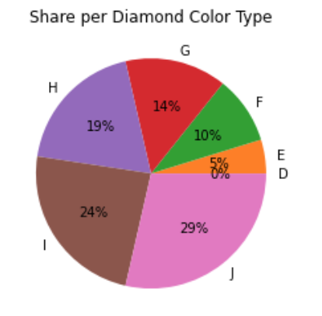
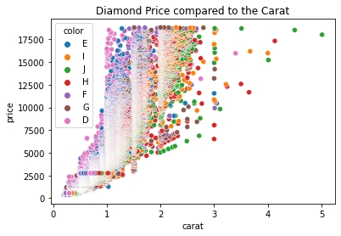
Pie Chart & Scattered Plot

Slide 9
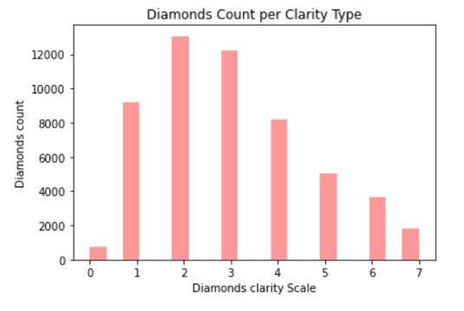
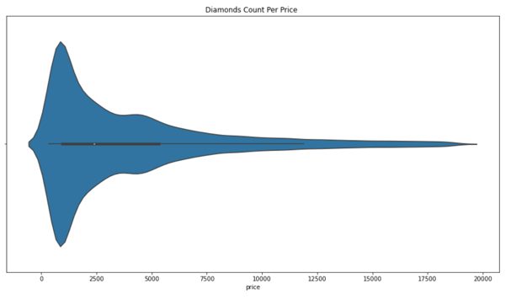
Bar Chart and Violin Plot

Slide 10
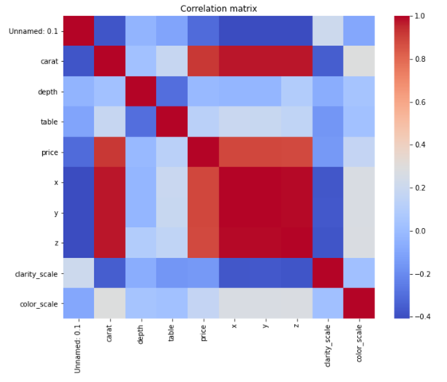
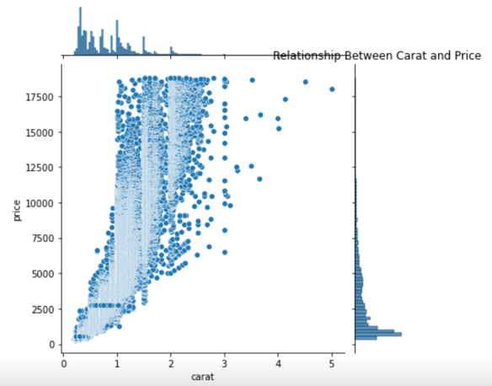
Join Chart & Correlation Matrix

Slide 11
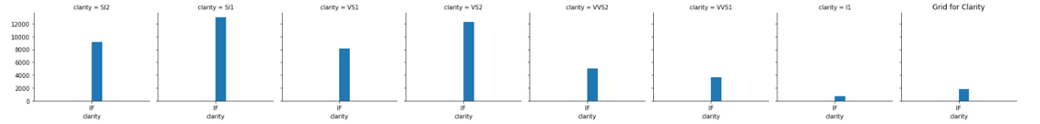
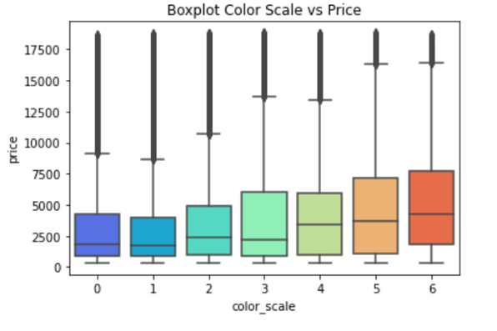
Boxplot & FacetGrid

